Slide 1

ACM Education Wrappers Workshop
By Caleb Kim & Farman Ali

Slide 2
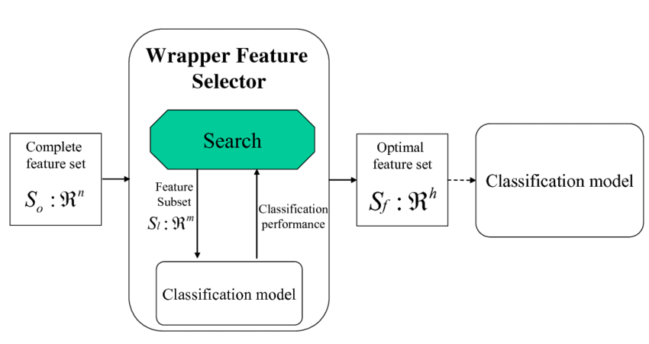
Introduction: What is a Wrapper Method in Machine Learning?
Wrapper methods is a popular class of feature selection algorithm that’s used in Machine Learning.
Feature selection is a process that picks out the most important pieces of information / features from a larger set.
This helps make the data easier to work with by reducing the total amount of information we need to analyze.
(good thing btw, less features to process turns into better performance!)
This is important in Machine Learning as it reduces dimensionality of the feature space, speeds up a learning algorithm, improves predictive accuracy of a classification algorithm, and improves comprehensibility of the learning results!

Slide 3
Chat Model Wrapper
Context Management and Memory
With the Wrapper: The wrapper maintains a "memory" of the conversation, enabling responses that consider past interactions. It dynamically manages which messages to keep or remove based on token limits, ensuring key context is preserved over extended conversations.
Without the Wrapper: You would need to manually handle conversation memory, adding and removing past messages yourself.
Consistency and Conversation Flow
With the Wrapper: The wrapper allows the model to prioritize recent or relevant messages, making responses consistent and coherent, especially in long conversations.
Without the Wrapper: Ensuring a coherent flow is challenging, as messages aren’t automatically sorted or prioritized. This often results in responses that feel disconnected from the prior conversation.

Slide 4
Block 5: Chat Model Wrapper
1. ChatMessage class
Represents a chat message with two attributes:
role: A string indicating the role (e.g., "user", "assistant").
content: The content of the message (text).
2. ChatMessageEncoder class
A custom JSON encoder to handle serializing ChatMessage objects.
Overrides the default method to:
Convert ChatMessage instances to a dictionary (__dict__).
Handle lists of ChatMessage objects by converting each to a dictionary.
Use the default JSON encoder if the object is neither of the above.
3. ChatModelWrapper class
A wrapper class around the OpenAI API, which allows for enhanced chat handling, including memory management and error handling.
What is a chat model wrapper?

Slide 5
Completion Model Wrapper
Context Management and Memory
With the Wrapper: The CompletionModelWrapper keeps a memory of past conversation exchanges, so responses consider what has already been said. It automatically removes older messages if memory becomes too large, keeping recent and relevant parts of the conversation to fit within the token limit.
Without the Wrapper: You would need to manually track which past messages to keep or remove for context, making it harder to maintain coherent and relevant conversations.
Consistency and Conversation Flow
With the Wrapper: The wrapper formats conversation history into a single, flowing prompt, ensuring the model understands the context from previous messages. This keeps responses consistent and relevant, especially in longer conversations.
Without the Wrapper: You’d have to handle this formatting yourself, and it’s easy to lose track of context, which can make responses feel disconnected.

Slide 6
Block 6: Completion Model Wrapper
1. CompletionModelWrapper class
This class wraps around an OpenAI completion model (such as "gpt-3.5-turbo-instruct") to add functionality like managing memory, retrying on errors, and generating responses with previous context.
2. _manage_memory method
Ensures stored conversation memory stays within the max_completion_token limit by calculating the token count of current and stored conversations.
Removes the oldest entries from memories until the token count falls within allowable limits, dynamically managing memory to prioritize the latest context.
3. _format_conversation method
Constructs a conversational prompt by joining past USER and AI messages, creating continuity in the dialogue.
Adds the current prompt to the formatted conversation history if use_memory is enabled, or returns only the current prompt if use_memory is disabled.
4. _completion method
Sends the formatted prompt to OpenAI’s API to generate a response, with built-in retry logic for handling temporary errors.
Returns the model’s response or None if all retries are exhausted, supporting a reliable and responsive completion request.
What is a completion model wrapper?

Slide 7
Block 7: LLM Wrapper
Context Management and Memory
With the Wrapper: if use_memory is enabled, the wrapper stores past messages to keep a consistent conversation flow. For chat models, it manages a message history; for completion models, it manages a prompt history. This memory is automatically managed to fit within token limits, keeping the context relevant.
Without the Wrapper: You would have to manually keep track of past interactions and decide which ones to keep or remove to stay within token limits, making it more challenging to maintain context in extended conversations.
Consistency and Conversation Flow
With the Wrapper: The generate_response method can handle both chat messages and prompts. It checks if the input is a single string (prompt) or a list of messages and then directs the request to the correct model type based on model_type. This keeps the code simple and unified, with one method to generate responses for both chat and completion models.
Without the Wrapper: You would need to create separate functions to generate responses for chat and completion models, making your code more complex and harder to manage.

Slide 8
LLM Wrapper
Provides a single interface for generating responses, regardless of the model type, by delegating the underlying work to either the ChatModelWrapper or CompletionModelWrapper, based on the specified model_type.
Unified Interface for Chat and Completion Models
Purpose: The LLMWrapper acts as a single point of access to both chat-based and completion-based language models.
How it Works: Based on the value of model_type ("Chat" or "Completion"), the wrapper chooses which underlying wrapper to use (either ChatModelWrapper for chat models or CompletionModelWrapper for completion models).
Benefit: This unifies the API call interface so users don’t need to worry about the specifics of which model type they’re using—they simply pass input and receive output.

Slide 9
How are Wrapper Methods Useful?
Classification Problems:
Helps select the most relevant features (like certain words, symptoms, or signals) to improve classification accuracy.
Examples: Spam detection & medical diagnosis.
Regression Problems:
Helps predictive modeling as they’re used to identify key predictors that can minimize prediction errors.
Examples: Predicting house prices & stock prices.
Natural Language Processing:
Helps in text-based applications as they’re used to identify key terms or phrases that influence the model’s prediction the most.
Examples: Document classification & sentiment analysis.
Computer Vision:
Helps application to image classification tasks (e.g. identifying objects in photos) to select the most relevant image features (like edges, textures) for improving performance.
Examples: Facial recognition, object detection, & autonomous vehicles.
Marketing & Customer Analytics:
Helps select features that predict customer behavior which helps in targeting marketing efforts or improving customer retention models.
Examples: buying patterns & customer churn.
Time-Series Analysis:
Helps identify which time-related features are most relevant for making accurate predictions.
Examples: weather prediction & stock market analysis.

Slide 10
Let’s Build a Chat Bot!

Slide 11
Notebook Link:
https://tinyurl.com/wrapperRepo

